Slide 1
Group 5

Slide 2



How do UK media outlets of differing political perspectives frame the Israeli-Palestinian conflict in November 2023, as analyzed through topic modeling?
This study focuses on the BBC, The Guardian, and The Telegraph. More specifically, shortly after the conflict intensified between the two parties, providing insight into the media's framing during this critical period.

Slide 3
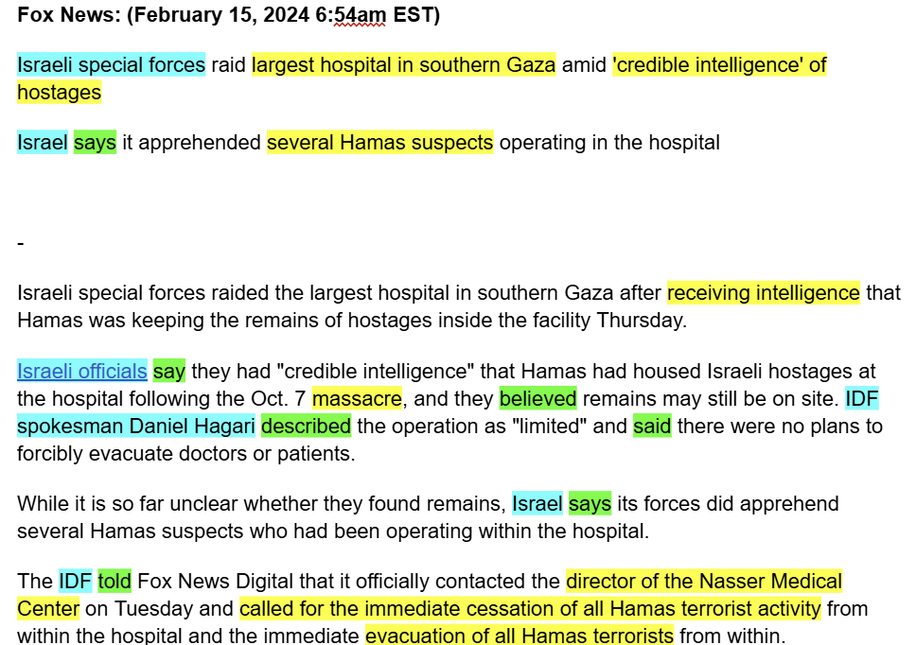

Slide 4
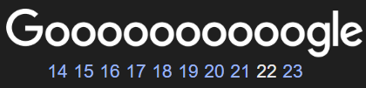

Challenges
Choosing and motivating media outlets & time period.
Creating our article database
How to preprocess

Slide 5
Our approach
Gather the relevant articles
Preprocess the data
Do our analysis (topic modelling, sentiment analysis)
Interpret our results and draw our conclusion
Make a poster

Slide 6
Form of the end result
BBC
Articles
Topics
Sentiments
Keywords
The Guardian
Articles
Topics
Sentiments
Keywords
The Telegraph
Articles
Topics
Sentiments
Keywords

Slide 7
Evaluation
In the process: ask for a lot of feedback
Looking critically to our results and analysis
Having peers read our paper

